Slide 1
Keras Tutorial
Codeprentice Workshop Series
Presenter: Dylan Drover

Slide 2
Overview
Geared towards and intermediate audience with some experience with DL and Keras
However, feel free to asks questions. The goal is clarity and understanding
What we’ll try to cover:
A review of Keras “under the hood”, i.e. TensorFlow and “The Graph”
Sequential vs. Functional API
Visualizations
Quantization and TFLite
Questions and Clarifications

Slide 3


Quick Overview of the DL API Landscape
Keras
Easy to use interface
High-level, with access and adaptability for low-level tinkering
Popular
Initially an interface to multiple backends, now it is fully integrated with TF
Similar interface to scikit-learn tools
Now supports eager execution (more on that later)
PyTorch
Build from ground up with Dynamic Graph
Very “Pythonic” way of doing things
Slightly lower-level, but still has high-level API functionality
Came from Torch, but they decided it didn’t make sense to have a library written in a language no one had heard of (Lua)

Slide 4

Quick Overview of the DL API Landscape
TensorFlow
Initially build around the idea of pre-compiled static compute graphs
Recently integrated more imperative “eager” execution
Easily quantized and packaged for edge device usage
Low-level, kinda a pain to deal with directly (hence why there are APIs for it..)
The Rest
MXNet, not bad, can do eager and static execution
Theano, old, clunky
Caffe, old, clunky
Many others, highly recommend this list: https://en.wikipedia.org/wiki/Comparison_of_deep-learning_software
Focus on the “Actively Developed” column

Slide 5
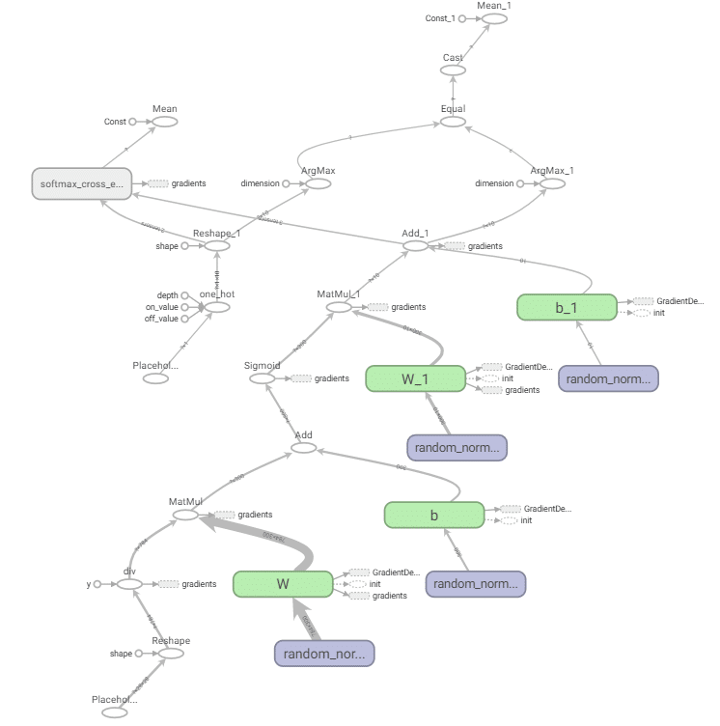
TensorFlow
Underlying framework of Keras
Think of TF not as a DL library...think of it as a differentiable computing library
Widely supported
Steep learning curve (hence, why we use Keras)
Large community
TFlite and Quantization

Slide 6
The Graph and Eager Execution
The Graph / Static Computation
Computation (your operations) are organized in a structure called The Graph, which is a DAG
The Graph is compiled at start time, without any exposure to data
Static and unchanging at runtime
Interface with the computation through Placeholder Tensors and Feed Dictionaries
No intermediate checking of values, terrible for debugging
Efficient to run, not to write
Eager Execution / Dynamic Graphs
Added in TF2.0
Using similar compute paradigm to PyTorch
Imperative, more “pythonic”, runs and evaluates at once
Can use python debugging tools
pdb.set_trace()
Check intermediate tensor values

Slide 7
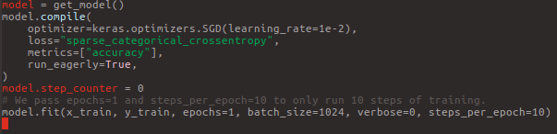
Eager Execution in Keras
To use eager execution:
When compiling your model, set “run_eagerly=True”
Run fit normally, and you will be able to stop the code within your model with pdb.set_trace()
Hugely improves ability to debug your code and model

Slide 8
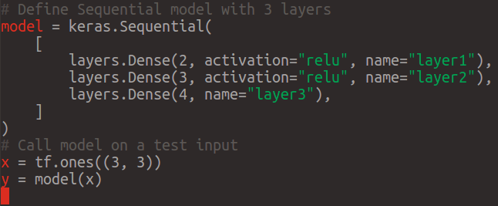
Sequential and Functional API
Sequential
Great for simple one input, one output models
Easily wrap some layers in the Sequential Wrapper, compile, and fit
Functional
Handles multiple inputs and output, including for intermediate layers
Layer Sharing
Branching models, multi-model data
Most Importantly, Residual Connections
Think of the API in an imperative way, an input to one layer is the output of another layer

Slide 9
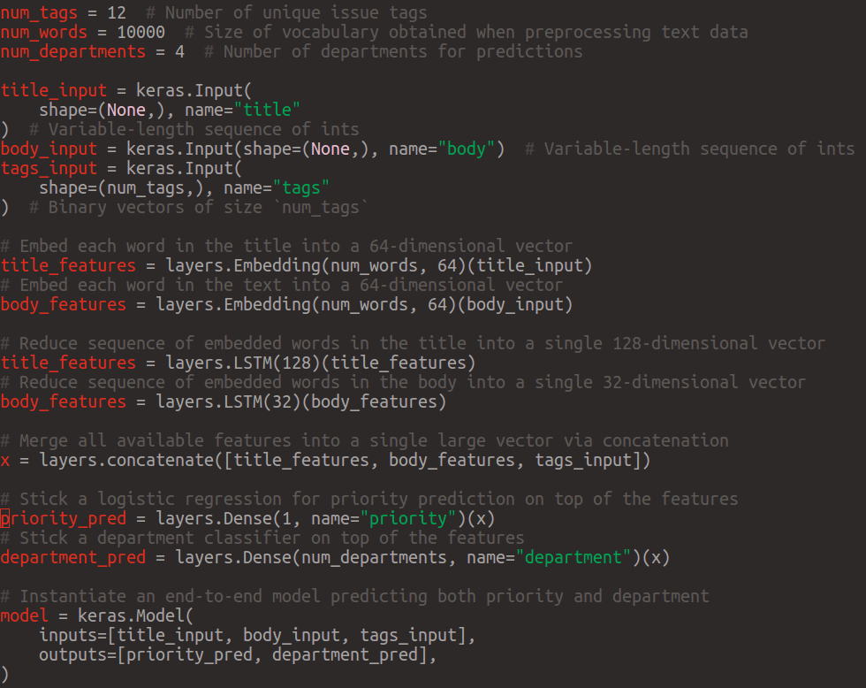
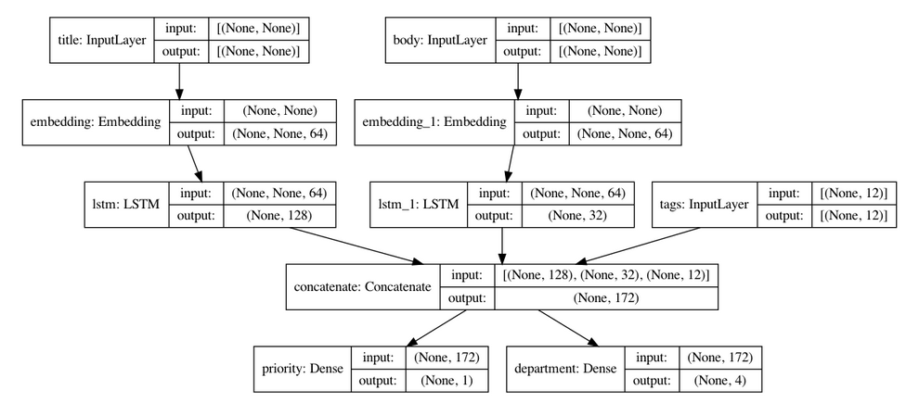
Functional Example

Slide 10
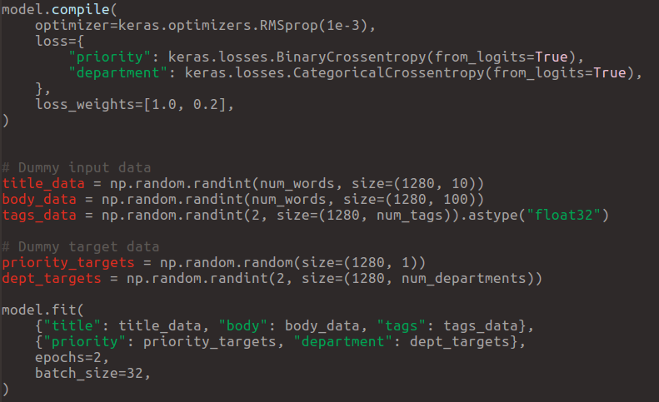
Functional Example
Allows multiple loss functions
Can assign weights
fit() uses names of graph nodes for inputing values

Slide 11
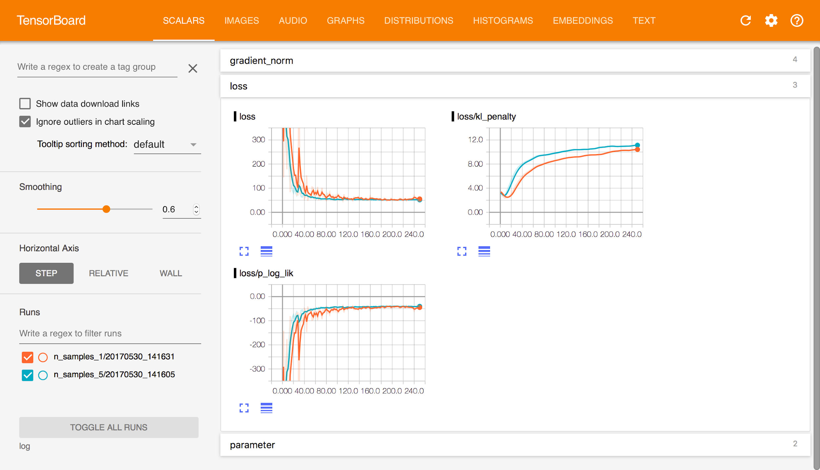
Tensorboard

Slide 12
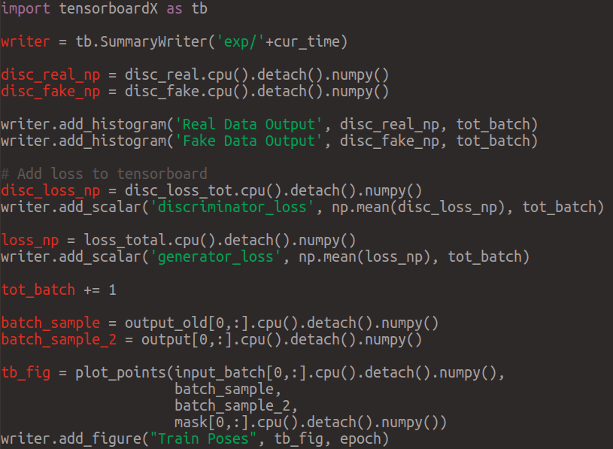
TensorboardX
Allows for use of numpy arrays and not Tensors
Allows for adding full Matplotlib figures to the “Images” tab
Able to be used for whatever DL API you’d like to use

Slide 13
Tensorboard in Keras
Used through callback in the fit function
While code is running: run $tensorboard --logdir=path_to_your_logs
Example: https://keras.io/api/callbacks/tensorboard/

Slide 14
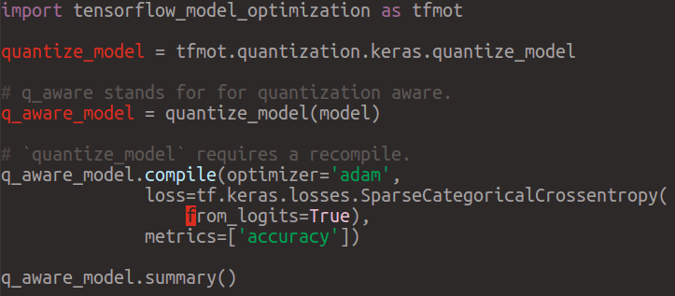
Quantization and TFLite
Quantization is the process of taking a high precision value and changing its representation to a less precise value (float32 -> int8)
Allows for large memory savings (25%-50% of original memory of network)
There is a performance tradeoff
Best results come from quantize aware training

Slide 15
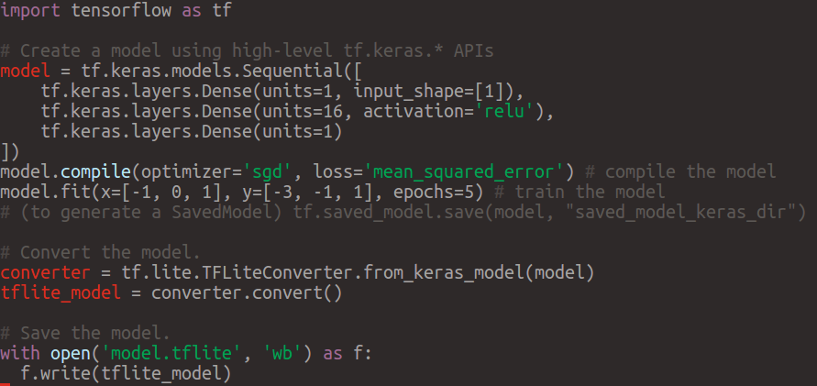
TFLite
A format for storing static models for inference
Portable to Edge devices, iOS, Android etc.
Some limitations on what operations are available but most of the major ones are
Pair quantization with TFLite model for small, portable models

Slide 16
Q&A
Contact: dylandrover@gmail.com

